Slide 1
Office Hours LIVE: Community Updates and Q and A
Subtitle in Title Case (If Needed)

Slide 2
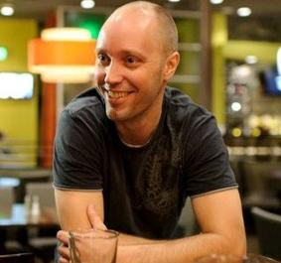
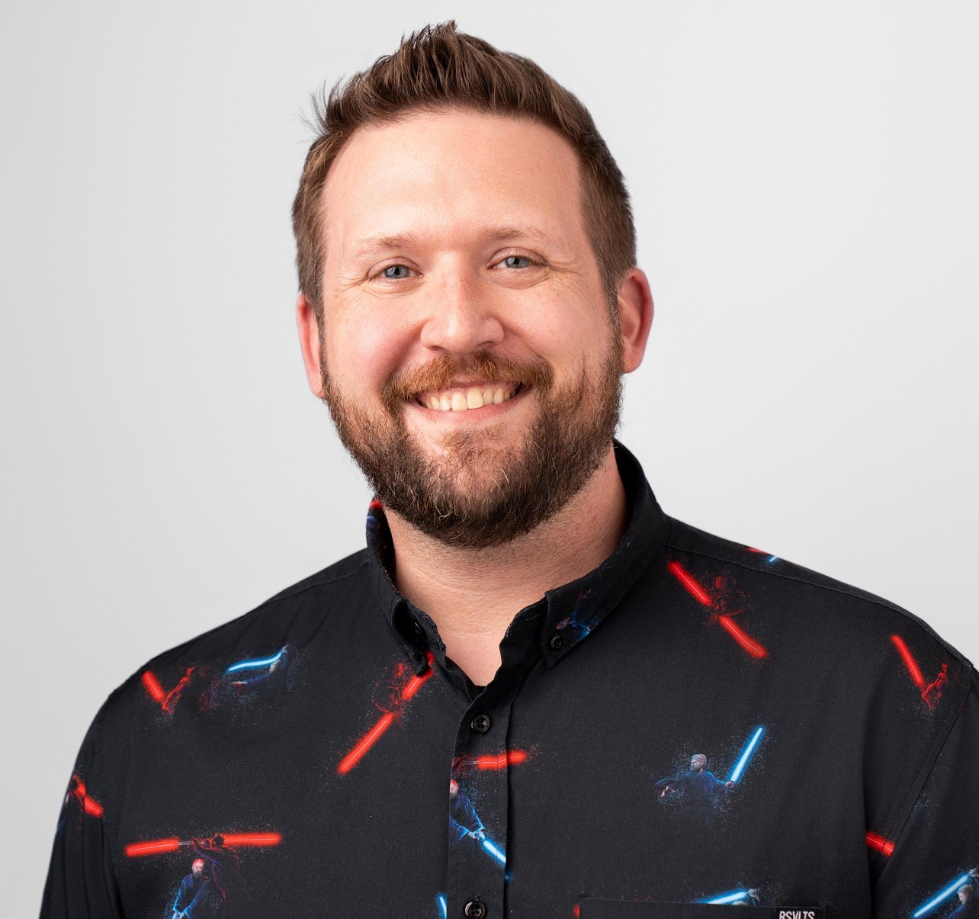


Johan Arwidmark
Andrew Johnson
Technical Fellow at ViaMonstra Online Academy
Solutions Architect
Johan.Arwidmark@mirolus.com
@jarwidmark
ajohnson@adm-solutions.net
@AndrewJNet

Slide 3
Office Hours LIVE

